Slide 1
Before we start:
Please feel free to ask us questions in the Hall and speak with with your young person’s Form Tutor - They really are your son/daughter’s expert in school
You can also leave any further questions or feedback on the postcards at the back of the Hall
Notes:
CKE

Slide 2
Welcome to our Year 11 Information Evening
Thursday 3rd October 2024

Slide 3
Year 11 Parents Information Evening
Thursday 3rd October 5.30-7PM
Outcomes for this evening:
What makes a successful Year 11 and the unique ethos for our year
Important themes and key dates
Support available for students at KS4- Meet the tutor and how parents/carers can support
Looking ahead and Next Steps
Notes:
WELCOME -CKE intros and outcomes for the evening

Slide 4
What makes a great Year 10?
Together
Develop habits of Good learning and revision
Looking ahead
Celebrating Success
Access Great Support
Attend School Everyday
Making the right start
Be that Role model: Giving Back
Knowing where you are at
Behave Well
Notes:
Cke Overview of all our values here

Slide 5
What makes a great Year 11?
Together
Develop habits of Good learning and revision
Looking ahead
Celebrating Success
Access Great Support
Attend School Everyday
Making the right start
Be that Role model: Giving Back
Knowing where you are at
Behave Well
Notes:
CKE Overview of all our values here

Slide 6
KS4 Unique Ethos
Together: team-supporting each other, mutual respect, behaving well, attending every day, looking ahead, taking responsibility
We
Grow: learning from our mistakes, practising the skills we need, rising to the challenge, giving back, inspiring others
And
Succeed: results you are proud of, no regrets, having choice about your future, being happy, feeling proud, grateful
Notes:
CKE

Slide 7
A Shared Ethos
“If we can work together, we are respectful and can take responsibility for our learning so we can grow, be ambitious and be resilient in our learning and succeed..”
T
G
S
Notes:
CKE

Slide 8
The Journey Ahead
Year 10 exams Late June 24
Report Home July 2024
Report Home October 2024
Summer Hols
November Mocks
Report Home December 2024
February/March Mocks
Report Home March 2025
May - June 2025
GCSE Exams
Tadcaster Grammar School Be Your Best Self
Notes:
CKE

Slide 9
Year 11 Key Dates - 2024/25
Parental/Student information and support event (1): Thursday 3 October
Reports (1): wb 21 October 2024
Mock examinations (1): 11-22 November 2024
Reports (2): wb 16 December 2024 (includes Mock exam results)
Year 11 Parents Evening: 15/16 January 2025
Parental/Student information and support event (2): Thursday 6 February
Mock examinations (2): 24 February - 7 March 2025
Reports (3): wb 31 March 2025
MFL speaking assessments will take place between April 1 - May 16
Drama practical assessments will take place between January 15 - May 31
(Specific dates will be communicated closer to these assessment windows)
2025 Exam dates: Start - week beginning Monday 5 May - End - week ending Friday 20 June
Contingency day - Wednesday 25 June)
RESULTS DAY - Thursday 21 August 2025
There are 30 school weeks from Sept 2024 to the provisional start of the GCSE period
There are 9 weeks from Sept 2024 to the Year 11 first Mock exams
There are 20 weeks until the start of the second Year 11 Mock exams
Start of term Wednesday 4th September - Please see School website for holiday and training day details
Notes:
MGI

Slide 10
GCSE Reports
Three throughout Year 10
Six issued at GCSE
Three throughout Year 11
Target Grades - an aspirational potential grade / Forecast Grades - potential outcome with current ‘approach’
BTEC subjects
Grade | Equivalence (GCSE)
Level 2 D* (Distinction*) | 8.5
Level 2 D (Distinction) | 7
Level 2 M (Merit) | 5.5
Level 2 P (Pass) | 4
Level 1 D (Distinction) | 3
Level 1 M (Merit) | 2
Level 2 P (Pass) | 1.25
9 - 1 Key Stage 4 grades
+
A broad guide as to how this links to historic grades in Key Stage 4
Grade | Equivalence
9 - 7 | (A*/A in Old money)
6 - 4 | (B/C in Old money)
3 - 1 | (D-G in Old money)
Entry Level of Functional skills qualifications in KS4
GCSE subjects
Tadcaster Grammar School Be Your Best Self
Notes:
MGI

Slide 11
“We firmly believe that having a fantastic attitude to learning is the key to success at TGS, no matter what your academic starting points are”.
We report on three key areas, using a 5 point scale for each.
Behaviour for Learning
Attitude to Learning
Homework
≈ 93% of all grades are awarded in these two categories
Any students falling into these categories will be spoken to in school about how to improve. Please also have these conversations at home.
The school sets the minimum benchmark at grade 2, with grade 1 awarded to students who go that extra mile
Detailed descriptors for each key area are included within each report.
Attitudinal Information
Grade | Grade Heading
1 | Outstanding
2 | Good
3 | Need for improvement
4 | Concerns
5 | Serious Concern
Tadcaster Grammar School Be Your Best Self
Notes:
MGI

Slide 12
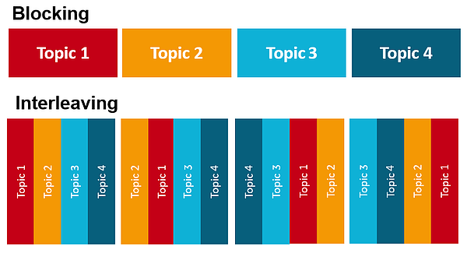
Support available for Students
at KS4
available on the school website
Period 1- we are running a programme of support on revision and coping with GCSE studies
One Stop Shop
TGS SUBJECT SPECIFIC GUIDANCE (INCLUDING HOW PARENTS CAN HELP)
Weekly student bulletin
Form Google Classroom
Timetable of revision sessions
Preparing for exams/revision
Tadcaster Grammar School Be Your Best Self
Notes:
CKE

Slide 13
There are lots of resources and supportive material
with the help of SPARX topics
As Mr Punt said on the Bulletin this morning, little and often
Foundation |  | Higher
Paper 1 |  | Paper 1
Paper 2 |  | Paper 2
Paper 3 |  | Paper 3
1) Read and review the topics eg B1 and B2 - about cells, microscopes, specialised cells etc
2) Make something - a concept map, a set of revision cards, a PowerPoint slide, linked key words sheet etc
3) Past Papers/Questions - use their revision materials and the open mark scheme to work through past paper materials
Science Revision Support
Tadcaster Grammar School Be Your Best Self
Notes:
CKE

Slide 14
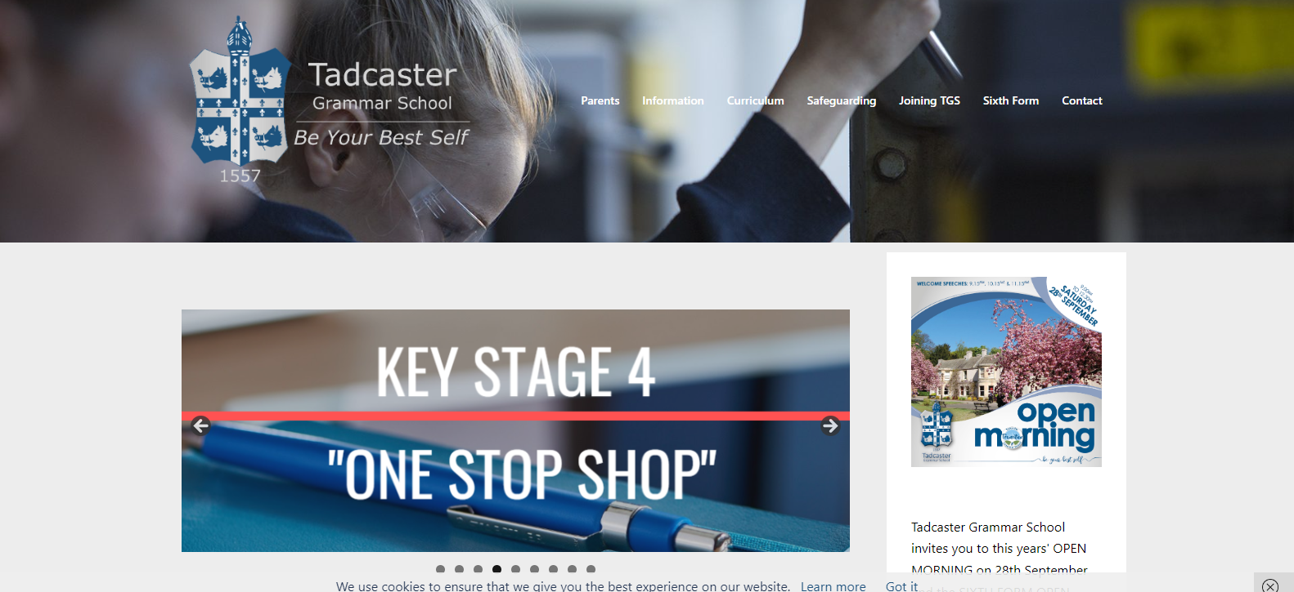
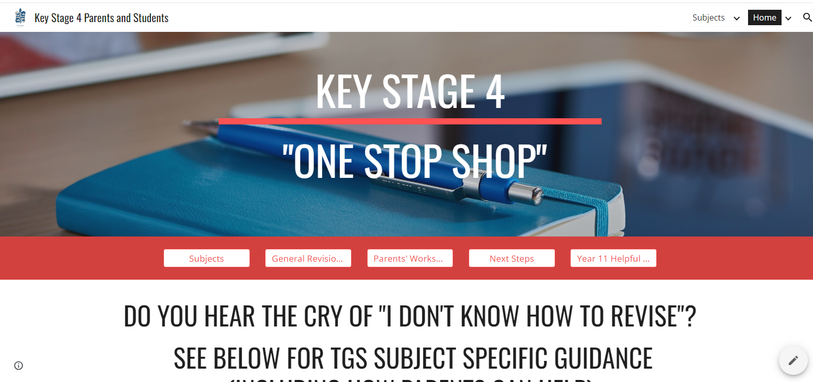
Click on the One Stop Shop banner on the home page or on the Year group information page
Click on the Parents link and select Year group information
Tadcaster Grammar School Be Your Best Self
Notes:
CKE

Slide 15
Year 11 Team
Messages continued….
The 3 Step Challenge (1)
Key messages.
Arrange a space at home that you can call your own for your studies.
Collect some materials to help you organise your work - folders, wallets, binders etc.
Sort your personal calendar - arrange your subjects so you know on which days you’ll complete your work i.e. Monday = Maths and Graphics, Tuesday = French, etc
Notes:
cke

Slide 16
Year 11 Team
Messages continued….
The 3 Step Challenge (2)
Key messages
Sort your personal calendar - arrange your subjects so you know on which days you’ll complete your work i.e. Monday = Maths and Graphics, Tuesday = French, etc
Complete 1 hour every day Monday to Thursday
Plan ahead and start to consider building in extra sessions available in school- look at the TT of extra support
Notes:
cke

Slide 17
Year 11 Revision Sessions - WEEK 1 (LUNCHTIME)
 | Monday | Tuesday | Wednesday | Thursday | Friday
Lunch time | 3D Design KS4 drop in P19 German KS4 drop-in lunchtimes in L3 RPE KS4 S12 (lead up to exams) Graphics WK1&2 12.35-1.05 P18 | 3D Design KS4 drop in P19 Art KS4 lunchtime drop in Photography KS4 lunchtime drop in Graphics WK1&2 12.35-1.05 P18 Drama Intervention/ Drop in English Poetry revision (up until the mocks only) Computer Science P22 | History KS4 drop-in lunchtimes in L11 3D Design KS4 drop in P19 Geography Year 11 Drop-In M28 Art KS4 lunchtime drop in Photography KS4 lunchtime drop in Drama Intervention/ Drop in Economics KS4 Lunchtime Intervention/Drop In S13 12.35-1.05 Chemistry KS4 Lunchtime Intervention/Drop In P8 12.35-1.05 | GCSE PE KS4 drop-in L6 French KS4 drop-in lunchtimes in L7 German KS4 drop-in lunchtimes in L3 Art KS4 lunchtime - appointments only Photography KS4 lunchtime - appointments only Graphics WK1&2 12.35-1.05 P18 Food Prep & Nutrition GCSE P15 lunchtime Business Studies KS4 Lunchtime Intervention /Drop In S13 12.35-1.05 | 3D Design KS4 drop in P19 Art KS4 lunchtime - appointments only Photography KS4 lunchtime - appointments only Graphics WK1&2 12.35-1.05 P18

Slide 18
Year 11 Revision Sessions - WEEK 1 (AFTER SCHOOL)
 | Monday | Tuesday | Wednesday | Thursday | Friday
After School | Art Yr 11 3.10-4.30pm Photography Yr 11 3.10–4.30pm (Due to meetings, this day will alter or be cancelled via GC- student must provide prior notice if they intend to use the session |  | Graphics WK1&2 KS4 drop in P18 - by appointment. WHOLE YEAR REVISION SUPPORT ILC 3.10-5.00pm | 3D Design KS4 drop in P19 - by appointment Graphics WK1&2 KS4 drop in P18 - by appointment WHOLE YEAR REVISION SUPPORT ILC 3.10-5.00pm

Slide 19
Year 11 Revision Sessions - WEEK 2 (LUNCHTIME)
 | Monday | Tuesday | Wednesday | Thursday | Friday
Lunch time | 3D Design KS4 drop in p19 Graphics WK1&2 12.35-1.05 P18 | 3D Design KS4 drop in p19 Art KS4 lunchtime drop in Photography KS4 lunchtime drop in Graphics WK1&2 12.35-1.05 P18 Drama Intervention/ Drop in English Poetry revision (up until the mocks only) Computer Science P22 | History KS4 drop-in lunchtimes in L11 3D Design KS4 drop in P19 Geography Year 11 Drop-In M28 Art KS4 lunchtime drop in Photography KS4 lunchtime drop in Drama Intervention/ Drop in Economics KS4 Lunchtime Intervention /Drop In S13 12.35 to 1.05 Chemistry KS4 Lunchtime Intervention/Drop In P8 12.35-1.05 | French KS4 drop-in lunchtimes in L7 Art KS4 lunchtime - appointments only Photography KS4 lunchtime - appointments only Food Prep & Nutrition GCSE P15 Lunchtime Graphics WK1&2 12.35-1.05 P18 Business Studies KS4 Lunchtime Intervention /Drop In S13 12.35-1.05 | 3D Design KS4 drop in P19 German KS4 drop-in lunchtimes in L3 Art KS4 lunchtime - appointments only Photography KS4 lunchtime - appointments only Graphics WK1&2 12.35-1.05 P18

Slide 20
Year 11 Revision Sessions - WEEK 2 (AFTER SCHOOL)
 | Monday | Tuesday | Wednesday | Thursday | Friday
After School | Art Yr 11 3.10-4.30pm Photography Yr 11 3.10–4.30pm (Due to meetings, this day will alter or be cancelled via GC- student must provide prior notice if they intend to use the session) |  | Graphics WK1&2 KS4 drop in P18 - by appointment WHOLE YEAR REVISION SUPPORT ILC 3.10-5.00pm | 3D Design KS4 drop in P19 - by appointment Graphics WK1&2 KS4 drop in P18 - by appointment WHOLE YEAR REVISION SUPPORT ILC 3.10-5.00pm

Slide 21
Every wed/thurs- Open to all YEAR 11 Students - Till 5PM
In the ILC
Starts Sept 23
Notes:
CKE

Slide 22
Revision!
Notes:
Cke or one of lasts years Y11 students

Slide 23
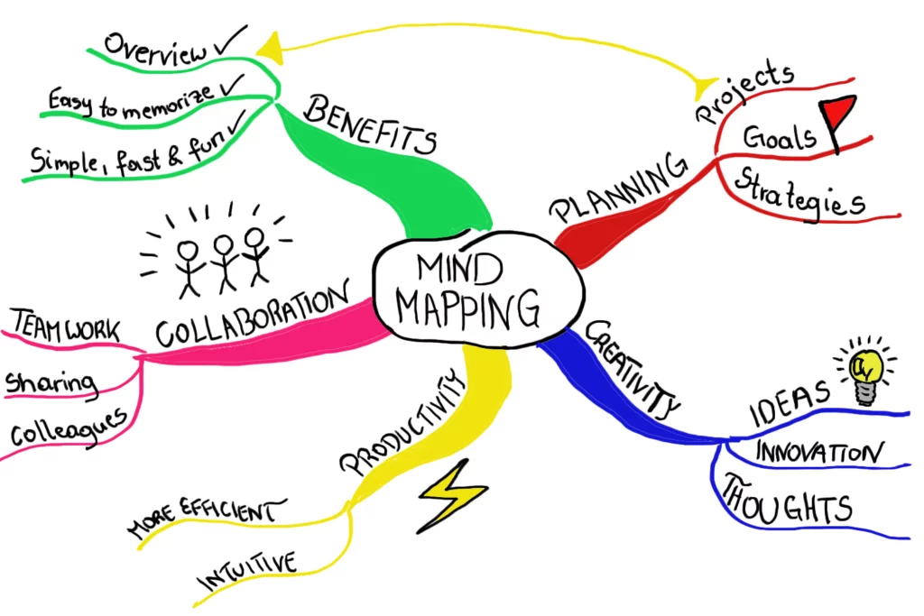
3 easy steps to REVISION:
(1) Review the topic/content - quickly read through the text book and/or your exercise book or use other physical/online revision resources.
(2) Use it/ Produce something - make a poster, concept map, revision cards, quizzes…. Try to do this from memory and then use notes/text books to fill in any gaps.
(3) Past papers + mark schemes - access and attempt past questions related to the topic and use the mark scheme(s) to help with any tricky bits - ‘bounce’ between the two.

Slide 24
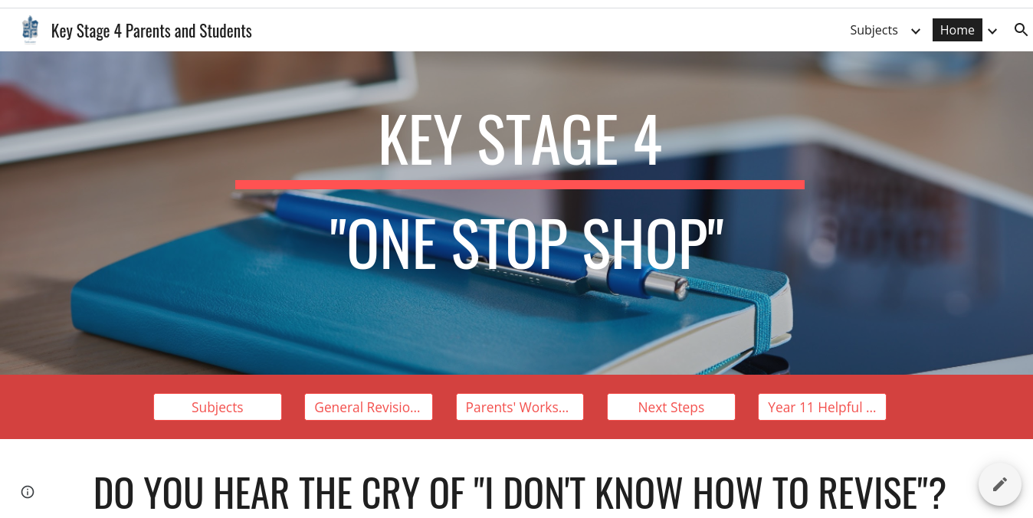
Where do I start?
Break the subject into easy to approach chunks/topics:
e.g. Biology - Review each of the 18 topics in turn. Some can be done together … Respiration and Photosynthesis (Topics 8 and 9)
e.g. RE - two big sections, Christianity and Islam, these sections can also be subdivided to make the revision easier.
e.g. English Literature (An Inspector Calls) - break the text into Characters, Themes, Chapters etc
Use the schools ‘One Stop Shop’ for further and subject specific advice, including appropriate tasks & activities for each subject.

Slide 25
Where & When to Revise?
4) Decide what time work will be done: E.g. Maths 5-6.30pm, Physics 7.30 - 9pm (Don’t work later than 9.30pm)
5) Break up the study sessions. Work for 20-30 minute chunks with 5 minute breaks over the hour/hour and a half.
6) Ensure that guilt free time
off is built into your revision plan/timetable....AND get lots
of SLEEP!
1) Find a quiet, calm, comfortable place to work.
2) Remove mobile devices, block social media or turn off notifications when working.
3) Use your revision timetable to decide which subjects you will study on each day. E.g. Mondays: Maths & Physics

Slide 26
The Revision Timetable
Planning! ...BORING, right? In reality,
a little planning will save a LOT
of time and allow you to have time
for doing the other things you love
to do…(crossword puzzles, basket weaving…?)
It is really important to plan your time carefully so you ensure you cover & revisit everything you need to prepare for your assessments. It will make you feel more organised =less worried. Win/Win!
You can start to plan now, we . still have lots of time. . . . Remember that planning breaks & time with friends and family is as important as planning time to revise, but you need to get the balance right.
Your teachers may have given you a revision list. There is also subject specific revision advice on the TGS website - ONE STOP SHOP. It’s GREAT idea to plan what type of revision you will do, rather than just the subject.
You can make a google sheet to create your own revision timetable. Collect a paper copy from the Year 11 office OR use this great online revision planner.
Or - you could write it on a calendar or draw out a timetable.
Whatever works for you!

Slide 27
Example-Weekly Revision Timetable
Monday
Maths - Hegarty
4.30-6.00pm
Biology - Past paper
7.30-9.00pm
To Do:
Art sketches to finish
Art folder to sort and stick in.
French - prep speaking
See Mr Sykes re: weak bits
Read Inspector Calls again
Friday
English Lang - revision workbook 40 mins
5.00-6.30pm
Art - artist study
7.30-9.00pm
Tuesday (*Eng revision lunch)
Physics - mind map P4
4.30-6.00pm
Chemistry - Exam questions
7.30-9.00pm
Saturday
RE - flip cards quotes
9.30-11.00am
French - random question generator
1.30-3.00pm
WEEKLY PLAN for REVISION
Wednesday
Maths tutor
4.00-5.00pm
Geography-case study flash cards
7.30-9.00pm
Thursday
Late back ….
English Lit. - Inspector character profile
7.30-9.00pm
Sunday
Homework and catch-up
10.00-11.30am

Slide 28
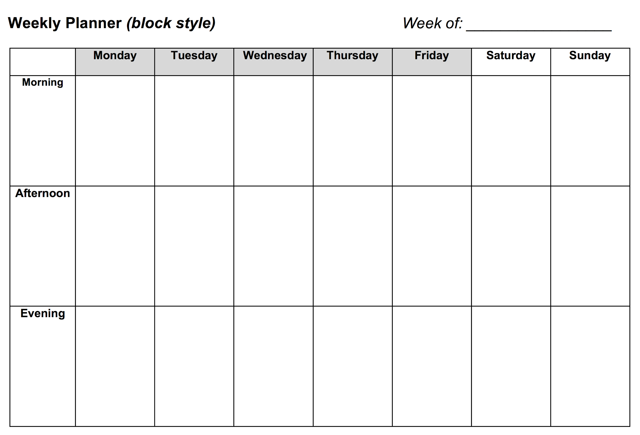
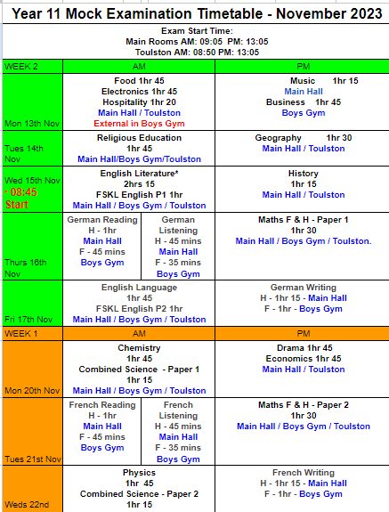
Useful
Resources
to take away:
Revision Planners
Mock Exam Timetables
Key Dates Postcard
Notes:
cke

Slide 29
SEND AND INCLUSION UPDATE
This approach focuses on the theory of Attachment and sustains itself on building strong, long-lasting relationships with key adults, in order to build trust and help support any needs, therefore allowing the children to be ready for learning.
Tadcaster Grammar School Be Your Best Self

Slide 30
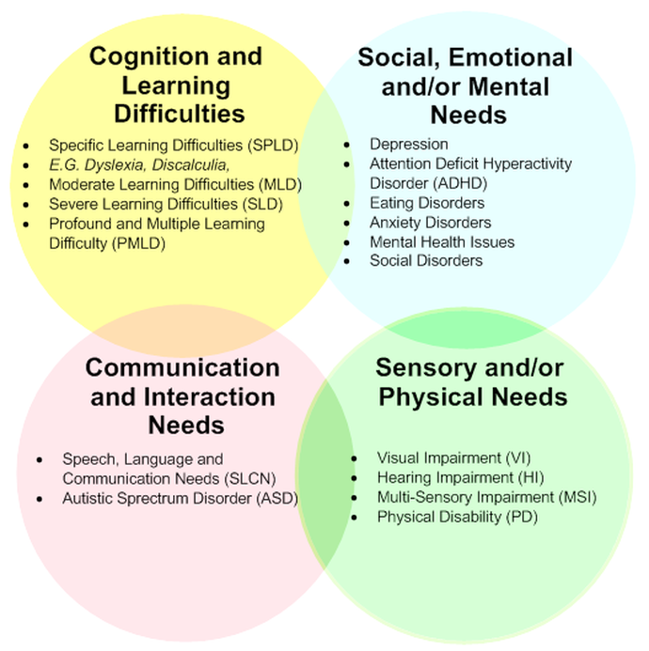
This could happen at any time - students who are in difficult circumstances which have led to them needing extra assistance
Tadcaster Grammar School Be Your Best Self
Tadcaster Grammar School Be Your Best Self
Notes:
cke

Slide 31
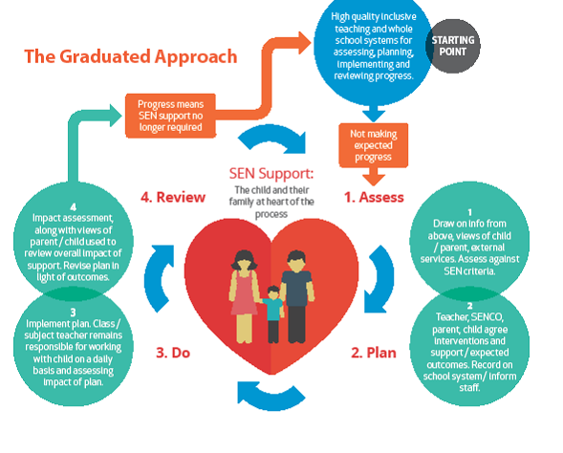
Our students, you as parents & carers, our teachers or external services can make us aware of any possible special educational needs.
We then start a process of assess, plan, do, review to establish whether additional support is needed.
Tadcaster Grammar School Be Your Best Self
Tadcaster Grammar School Be Your Best Self
Notes:
cke

Slide 32
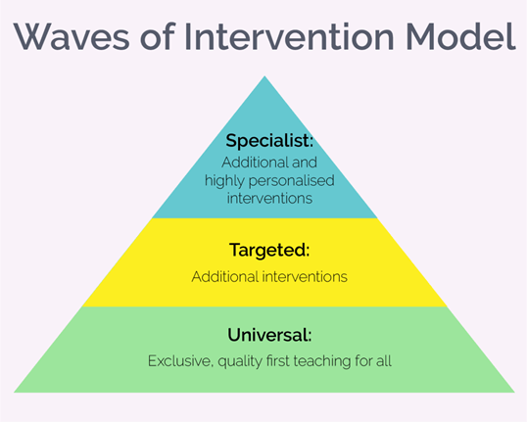
Ways in which we support students with additional need:
However, things continue to change….
Quality First Teaching
Tadcaster Grammar School Be Your Best Self
Tadcaster Grammar School Be Your Best Self
Notes:
cke

Slide 33
If our young people are in good health mentally and physically, they are better able to cope and when they feel positive, they are more open to new ideas, creativity and change, making them more effective and innovative in the classroom.
Please speak to your tutor, Pastoral Leader or Year Leader and have a chat or email them if you have any concerns about your wellbeing or the wellbeing of someone you know. You can also check out these useful links
Teen sleep hub
Anxiety/Stress factsheets
Wellbeing
External services working with in school:
Just B
Wellbeing in Mind Team
Tutor programme of support
You will find a number of useful websites to help manage stress/anxiety:
Managing Exam Stress
Shout text service
The Mix
Relaxation Tips for Positive Wellbeing
Wellbeing Wednesday
Tadcaster Grammar School Be Your Best Self
Notes:
CKE

Slide 34
Wellbeing and Mental Health Support
for Young People available in North Yorkshire
The Go-To website - houses the marketplace and a summary of the services available to young people that can be accessed by all services in Education.
Go to website
Plus a really useful animation
Notes:
CKE

Slide 35
How Parents can support in Year 11?
Listen -Encourage ‘off loading!’ Remind them of different support available to them at school- talk to us, use your staff, other students.
Please keep in touch- Get in touch with your son/daughter’s Form tutor / Year team.
Subject teachers can also be contacted for specific details - see link
Encourage revision- Could use school resources to make a start, supervise, clear a suitable space, help with organisation.
Notes:
MGI

Slide 36
Three top tips explained
‘Helping them through it’
Number 1 - create a study space
Number 2 - silent focus
Number 3 - Danger of distractions and mobile phones
Notes:
MGI

Slide 37
Create a study space
https://www.fromthesidelines.uk/
Notes:
MGI

Slide 38
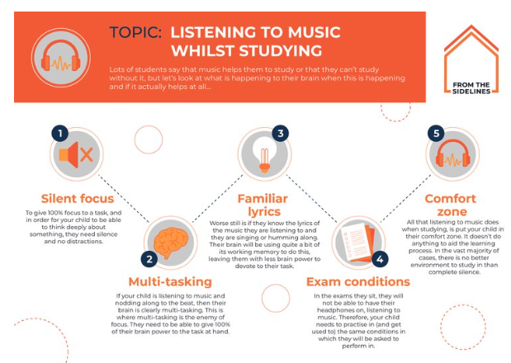
Silent focus
https://www.fromthesidelines.uk/
Notes:
MGI

Slide 39
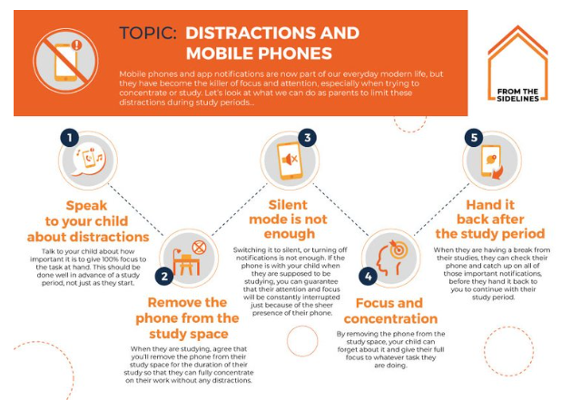
Danger of distractions and mobile phones
https://www.fromthesidelines.uk/
Notes:
MGI

Slide 40
…. and mobile phones
Screen time
UK teenagers:
8 hours 40 minutes per day on average.
More than 4 months per year.
If cut by 2 hours per day, that’s 700 extra hours each year.
“To reach an advanced level in a foreign language you will need…
…480 hours.”
Notes:
MGI

Slide 41
How Students can help themselves in
Year 11?
Be in school - make every lesson count
Make Year 11 count - Good learning habits build momentum, recognise your potential, learn from your mistakes, Do the day job!
Get in a daily routine of study - little and often is key.
Make sure they have a quiet space to work, with no distractions. No TV. No phone. No XBox.
Use the teaching staff and the many resources to support revision and wellbeing.
Avoid studying for some subjects and ignoring others.
Healthy lifestyle and good nutrition are even more important than ever.
Sleep is key to effective learning and various research studies show that good sleep patterns help learners consolidate knowledge whereas a lack of sleep results in poor coping strategies for managing stress.
Notes:
MGI

Slide 42
What are your child’s options after Year 11?
To remain in some form of education or training until their 18th birthday
● Full-time education: College or Sixth Form
● Apprenticeship
● Combination of learning and earning which must include a minimum of 20 hours working or volunteering, while in part-time education or training.
Doing nothing - a gap year is not an option.
If your child fails to secure an approved Post 16 destination they will be classified as a ‘NEET’.
(NEET stands for 'Not in Education, Employment or Training’). This can impact your access to child benefit for them.
When your child leaves approved education or training, payments will stop at the end of February, 31 May, 31 August or 30 November (whichever comes first).
Tadcaster Grammar School Be Your Best Self
Notes:
HLA

Slide 43
Tadcaster Grammar School Be Your Best Self
Notes:
HLA

Slide 44
Study subjects that they enjoy and excel at.
Be realistic about course choice.
Explore academic, technical and vocational pathways.
Make decisions based on information and not influence.
Forward plan beyond the next stage.
What we ask of students
What we ask of you to support your child ...
Is there an apprenticeship route?
Will your child be workplace ready after finishing Year 11?
be curious, be inquisitive, be open-minded
What’s your child's predicted grades?
Are they being realistic with their course choices?
To be knowledgeable about Post 16 qualifications and the opportunities they can lead to.
Encourage your child to have a Plan B option.
What subjects does your child excel in and enjoy at school?
Are there new subjects or courses they can study?
What's your child's learning style?
Do they want to continue in full time education?
You will be an influence on your child's choices.
It's important to aid the decision making process and not dictate it!
Tadcaster Grammar School Be Your Best Self
Notes:
HLA

Slide 45
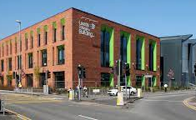
We support every student
Application support
Apprenticeship guidance - Future Me Apprentice
Post 16 Destination one to one discussion*
Dedicated Tutor time for supporting Post 16
and introduction to Post 18 Pathways
Employer Talks
Interview preparation
Mentoring Support
Post 16 Guidance Drop-in every half term during Period 1
All the above support continues for those students who join our Sixth Form
*Sixth Form - Post 18 and career planning discussion
Tadcaster Grammar School Be Your Best Self
Notes:
HLA

Slide 46
New for 2024/25
Parent/Carer Presentation from The Ask Programme.
Future Me - Apprentice
Half termly period 1 drop-in sessions for students seeking an apprenticeship.
Apprenticeships are a viable and rewarding option for post-16 students, offering a blend of education and practical work experience. To research and apply a student does need to set aside time to do this.
Vacancies may not always align with the number of people seeking placements. For example, there may be more applicants than available roles in certain trades.
Tadcaster Grammar School Be Your Best Self

Slide 47
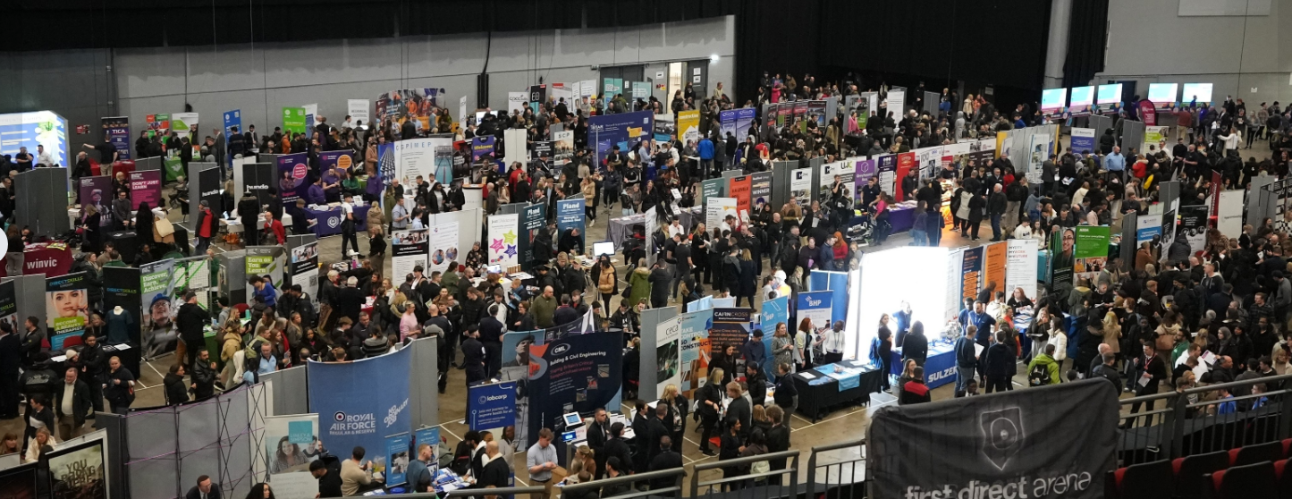
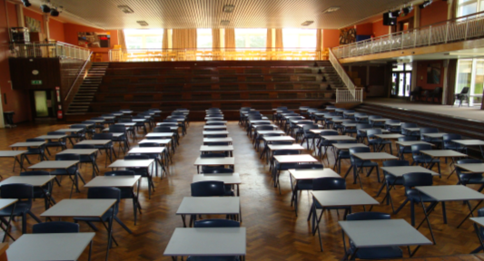
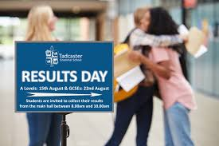
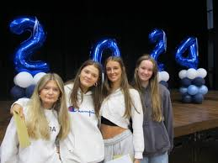
KEY DATES
September 2024 - June 2025 Attend open events/career fairs and submit applications*
September 2024 - August 2025 Apprenticeship Apprenticeship recruitment
January - August 2025 Attend interviews and receive conditional offers
May - June 2025 GCSE exam period
August 2025 Receive GCSE results and confirm Post 16 Destination
No later than September 2025: Start Post 16 destination
*please check individual Post 16 provider’s website for details of their application deadline. Deadlines for applications vary between providers.
Early submission of applications is recommended prior to the published deadline.
Tadcaster Grammar School Be Your Best Self

Slide 48
Support for parents/carers
Links to websites and publications to support parents and carers to help guide their child with career planning and school leaver options. Click on the links to access information:
An overview of Post 16 qualifications
Sixth Form at Tadcaster Grammar School
City of York Post-16 guide 2023/24/ (2024/25 pending)
Post 16 education in the Leeds Area
Further Education Open Event Information (8 October 2024 4pm-7pm - Leeds)
Guide to University
Guide to Apprenticeships
Guide to Engineering Careers Leaflet
UCAS Information for Parents and Careers
Parents Guide to T Levels
Post 16 Provider's Information and 2024/25 Open Event Dates
Tadcaster Grammar School Be Your Best Self
Notes:
HLA

Slide 49
Tadcaster Grammar School Sixth Form
We are incredibly proud of our excellent Sixth Form provision, offering over 30 A Level and BTEC subjects to students. Prospectus.
Not only do we provide our teaching delivered by subject specialist staff. We also offer a variety of opportunities for students to develop their leadership and employment skills through our extra curricular programme.
Alongside this, we have a superb pastoral care and personal development provision looking after the wellbeing and supporting the futures of all our students.
The success of our Sixth Form is evident by the destinations of our Year 13 students with 100% of 2024 leavers having secured a pathway of University, Apprenticeships, Employment or a Gap Year.
Sixth Form Open Evening Thursday 10th October 2024
Notes:
MGI

Slide 50
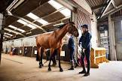
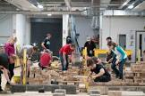
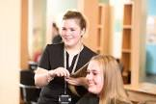
Po Post 16 College Information events 2024/25
19 October 2024
30 November 2024
25 January 2025
Click here to find out more...
Selected dates from
23 October 2024
Click here to find out more...
As a Year 11 school leaver you must remain in some form of education or training until your 18th birthday.
Your options are:
● stay in full-time education; Post 16 study at college or sixth form.
● start an apprenticeship or traineeship
● spend 20 hours or more a week working or volunteering, while in part-time education or training.
Selected Dates from
8 October 2024 to 19 June 2025
Click here to find out more.
Selected dates from
12 October 2024
to 14 June 2025
Click here to find out more...
Selected Dates from
16 October 2024
Click here to find out more
16 October 2024
to the
12 February 2025
Click here to find out more..
17 October 2024 - 12 February 2025
Click here to find out more...
From 16 October 2024 to
26 April 2025 various
open day events
across all sites
Check website for further details.
Notes:
HLA

Slide 51
Please feel free to ask us questions in the Hall and speak with with your young person’s Form Tutor- They really are your son/daughter’s expert in school
You can also leave any further questions or feedback on the postcards
Many thanks for attending and your continued support
Notes:
CKE

Slide 52
Year 11 Parents Information Evening
Feedback Postcard: Please let us know if you have any feedback or if you would like us to get back to you. Please provide a brief comment and contact details if needed and we will be in touch. Many thanks for your continued support.
Notes:
To print - revision planners and year 11 mock timetable

