Slide 1


GCSE English Language
GCSE English Literature
Year 10 2025-26
Top Advice:
Language:
Know the format of the exam e.g. the order of questions and number of marks.
Learn the success criteria for the questions.
Practise the questions you find most challenging using past papers.
Re-draft answers you have written in class using your targets.
Read a variety of fiction and non-fiction texts.
Literature:
Create flashcards for Literature texts to self quiz - learn your quotes.
Test yourself on your knowledge of plot, characters, themes, context and key quotes: focus revision on your weak spots.
Self assess your knowledge of all poems; revise the ones you are weakest on.
Ensure you know how the poems compare with one another.
Plan and write practice essay questions for all Literature texts.
Key Dates for Year 10:
w/c 17th December 2025
preparation of NEA Spoken Language (to be worked on over the holiday) and assessed in January 2026.
January 2026
Literature Paper 2 - An Inspector Calls assessment in class
May 2026
Literature Paper 1 - Macbeth assessment in class
June 2026
Language Paper 1 mock exam
Revision support:
Mr Bruff on YouTube for Literature texts
BBC Bitesize
Past Papers - One Stop Shop/AQA website
Subject Leader: Miss Carson - c.carson@tgs.starmat.uk
KS4 Leader: Mrs Kay - j.kay@tgs.starmat.uk

Slide 2

GCSE Maths
Year 10 2025-26
Top Advice:
Little and often is the best way to do Maths revision - there is a fantastic online resource from Corbettmaths called 5-a-days - there are 5 questions for EVERY day of the year (with answers).
Use the Sparx-linked revision lists sent out by Mrs Stubbs (check your Classroom or inbox).
Complete as many Past Papers as you can and mark them against the mark scheme. You can find them all here:
MAKE SURE YOU HAVE ALL THE RIGHT EQUIPMENT
Key Dates for Y10:
November 2025 - Full 3 paper mock
February / March 2026 - Full 3 paper mock
You will get traffic-lighted, question level feedback for each of your mock exam papers - keep them and use them with Sparx to improve.
Access revisions materials below:
https://sites.google.com/tgs.starmat.uk/years7-11mathstgs/revision
Subject Leader:
Mr Power - r.power@tgs.starmat.uk
Little and often is the key to success!

Slide 3
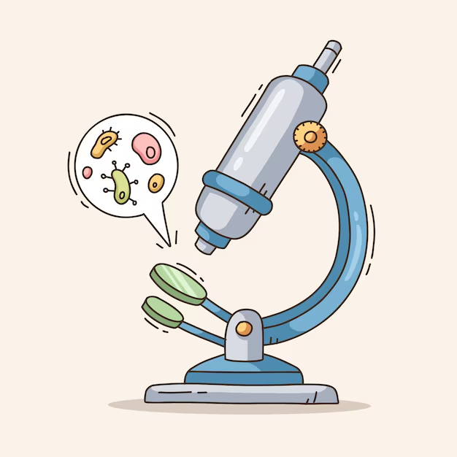
GCSE Biology
Year 10 2025-26
Top Advice:
Start your revision early to ensure you have time to cover ALL of the topics.
Practice and mark as many past paper questions as possible.
ASK a teacher if you come across something in your revision which you do not understand.
Have a good understanding of each of the required practicals
Make a glossary of key Biology terminology.
Remember to bring a pen, pencil, ruler, rubber and calculator to your exam.
Key Dates:
June 2026 - Paper 1 Mock
November 2026 - Paper 1 Mock
February / March 2027 - Paper 2 Mock
Assessment InformatioN:
2 exams at the end of Year 11:
Paper 1: Topics B1-B9
Paper 2:Topics B10-B18
Subject Leader: Mrs Farren
s.farren@tgs.starmat.uk
Do the best job that you can do.

Slide 4

GCSE Chemistry
Year 10 2025-26
(Include an appropriate subject related image)
Top Advice:
Go over content regularly- space your revision out and go over previous topics, not just your favourite topics
PAST PAPER PRACTICE is key!
All past papers are available on a link in your google classroom. Have a go, check the mark scheme and then ask your teacher if you still don’t understand
Little and often is better than leaving it until the end, trying a few questions a week will help hugely.
Learn your required practicals inside out
Make sure you have a calculator, pen, pencil and ruler for your exams!
Key Dates:
June 2026 - Paper 1 Mock
November 2026 - Paper 1 Mock
February / March 2027 - Paper 2 Mock
Assessment Information:
2 exams at the end of Year 11:
Paper 1: Topics C1-C7
Paper 2:Topics C8-C15
Subject Leader: Ms Holmes
k.holmes@tgs.starmat.uk
It doesn’t matter what others are doing, it matters what you are doing

Slide 5

GCSE Physics
Year 10 2025-26
Top Advice:
Start your revision early to ensure you have time to cover ALL of the topics.
Practice and mark as many past paper questions as possible.
ASK a teacher if you come across something in your revision which you do not understand.
Have a good understanding of each of the required practicals
Make a glossary of key Physics terminology.
Remember to bring a pen, pencil, ruler, rubber and calculator to your exam.
Key Dates:
June 2026 - Paper 1 Mock
November 2026 - Paper 1 Mock
February / March 2027 - Paper 2 Mock
Assessment Information:
There will be two exams at the end of Year 11:
Paper 1: Topics P1-P7
Paper 2:Topics P8-P16
Subject Leader: Mr. Sharratt
s.sharratt@tgs.starmat.uk
Do the best job that you can do.

Slide 6

GCSE Geography
Year 10 2025-26
Top Advice:
Please be fully equipped for all Geography lessons - charged chromebook, book, equipment.
Use the topic summary sheets given to you to RAG the topic as you go through - R = red = areas you MUST revise, A = amber = an area you need to look at again, G = green = confident at it!
Use your revision guide to help you revise topics as you go through the year.
Speak to your teacher if there are any concerns, the earlier the better - please always ask for help.
Please ensure all homework is completed on time and handed in so your teacher can provide feedback.
Key Dates for Y10 - Year 10 Mock Exam in June 2026
York Fieldwork- Thursday 4th June 2026
Revision sessions Wednesday lunchtime in M28 (Summer Term)
Key Websites/resources:
Your Google Classroom - here you will find all your lesson resources, homework information and revision resources.
The One Stop Shop for revision resources
AQA past papers - AQA website
Revision Guide
Kerboodle - here you will find the textbook we use in lesson time.
Year 10 Geography Teachers:
Mrs Walker - j.walker@tgs.starmat.uk
Mr Hamley- j.hamley@tgs.starmat.uk
Mrs Ireland - l.ireland@tgs.starmat.uk
Miss Richards- s.richards@tgs.starmat.uk

Slide 7
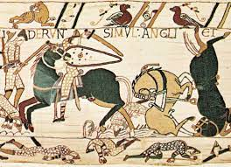
GCSE History
Year 10 2025-26
Top Advice:
Keep up to date with your booklets - if you need support / have questions, remember the Wednesday lunchtime drop-in session (L10).
Complete all homework.
Check your knowledge regularly - self-quiz, repeat the retrieval tasks, make your own flashcards AND use them!
You can log onto Classroom 42 to complete quizzes, media clips and complete exam questions (which are marked for you).
Prepare for assessments - completed regularly in class and focused around exam questions from past papers (past paper question grids).
Use past papers to answer exam questions or to plan answers for the extended writing questions. Ask for them marking.
Key Dates for Y10:
Exam board = Edexcel
Year 10 topics:
Topic 1: Paper 2: Anglo-Saxons and Normans - September through until January
Topic 2: Paper 31: Medicine through time - Easter and Summer terms
Year 10 mock in summer term: Anglo-Saxons and Normans
Year 11 mock in November will be Paper 1: Medicine through time
Subject Leader: Andrew Crease a.crease@tgs.starmat.uk
KS4: l.bland@tgs.starmat.uk

Slide 8


TOP ADVICE :
Learn and review your vocabulary regularly
Complete all homework set
Complete all key questions for each module
Learn your key questions for each module
Ask if you need help (French GCSE drop-in every Tuesday lunchtime)
Watch films/series in French
Use the revision guide and workbook
Try Duolingo
KEY DATES for Y10:
December
Module 1 assessment
(FREE TIME):
Listening, Reading and Writing
March
Module 2 assessment
(FAMILY AND FRIENDS):
Listening, Reading and Speaking
June:
Y10 mock exam: Modules 1,2 and 3 (SCHOOL) Reading, Listening and Writing
GCSE French
Year 10 2025-26
Subject Leader: Mrs Marie-Claire Butterworth m.butterworth@tgs.starmat.uk
Little and often is the key to success!

Slide 9

GCSE German
Year 10 2025-26
Top Advice:
Review and learn your vocabulary on each of the modules.
Complete your homework each week, making sure all the Active Hub activities are done.
Complete the answers to all key questions on each module (you will need them for the speaking and writing papers) Learn them once completed.
Listen to the language and watch German films and TV programmes whenever you can.
Ask if you need help/extra resources
Come to the German GCSE drop-in on Thursdays at lunchtime in L3.
Key Dates for Y10:
November/ December: School
Module 1: Zurück zur Schule
Listening, Reading, Writing and Speaking
February: Freetime and Hobbies
Module 2: Endlich mal Freizeit! Listening, Reading, Writing, Speaking
June (End of Year 10 exam) My World
Module 3: Meine Welt, deine Welt Listening, Reading, Writing, Speaking
Also feel free to include a final message of
German Subject Leader and teachers:
Miss Jackson: b.jackson@tgs.starmat.co.uk
Mrs Baker: t.baker@tgs.starmat.co.uk
Mr O’Neill: t.o'neill@tgs.starmat.uk
Learn your vocabulary on the bus!

Slide 10




Year 10 2025-26
GCSE Art and Design
GCSE Photography
GCSE photography allows our students to engage in lens-based art, which encourages them to be imaginative, thoughtful and technical whilst also balancing this with the ability to analyse, deconstruct and explore the work of photographers and artists.
There is an expectation that student transfer images from devices when at home to be able to engage fully in lesson time activities.
Students have a Photoshop Licence, we encourage them to ‘play’ and learn regularly with the software.
They require the Adobe Creative App on their phones.
They require there school drive & email set up on their mobile phones.
The success of this subject is down to the commitment shown by our students. We encourage taking creative risks, thinking critically and mastering technique through exploring, investigating and refining with fluency. There are 4 Assessment Objectives that need covering which are worth 25% of the overall grade each.
Time management & self-motivation is needed inside and outside of the lesson.
Curriculum Team Leader:
Ms Catherine Yewman
c.yewman@tgs.starmat.uk
Every lesson counts: attendance, productivity and positive working relationships during lessons is the key to success.
Both courses have 2 components.
Component 1: 60% of the overall mark is on-going coursework.
Component 2: 40% is exam work.
Both of which involves practical work leading to final outcomes.
-Each lesson students need to arrive with their book and equipment.
-Students are encouraged to regularly check their Google Classroom to reinforce lesson learning, find useful support on practical and written outcomes, alongside keep up to date with out of lesson work.
-It is vital students keep up to date. Students need to consistently meet deadlines set to benefit lesson to lesson.
The Art Department is open 4 days a week (break/lunch) for students to access support and specialist materials.
We believe that every child should enjoy a rich and balanced curriculum and we are privileged to teach in a school where creativity is a valued and celebrated skill.

Slide 11

GCSE Computer Science
Year 10 2025-26
Top Advice:
Keep up with practicing coding
Make sure you know all your definitions and key terminology - flashcards work well to test yourself
Attend lunchtime revision sessions
Use all the resources on Google Classrooms - this covers your whole course
Work on past papers to practice exam technique
Use the revision links to test yourself
If you need help, just ask
Key Information:
Our exam board is Cambridge OCR
Component 1 exam: Computer Systems is first, it is 1.5 hours
Component 2 exam: Computational Thinking will include written coding, also 1.5 hours.
.
Revision Links:
https://isaaccomputerscience.org/
https://senecalearning.com/en-GB/
https://www.physicsandmathstutor.com/
https://craigndave.org/ocr-gcse-j277-videos/
Subject Leader: Mrs Langstaff k.langstaff@tgs.starmat.uk

Slide 12

GCSE Creative Media
Year 10 2025-26
Top Advice:
Use the subject’s Google Classroom to keep up to date with work and deadlines.
Revisit presentations posted in the Google Classroom to embed your knowledge of the subject.
Use lunchtimes to make further progress with work and practise skills in Adobe software. You can also do this at home if you have a device on which you can use Adobe software.
Always use correct Creative Media terminology when analysing existing media products and your own design work.
Presentation is very important. Look at examples of media products for inspiration.
Be observant: Notice Media Products around you.
Always ask for support when needed.
Key Dates for Year 10:
Unit 1 Exploring Media Product (30% internal assessment)
Unit 2 Developing Digital Media Production Skills (30% internal assessment) -
Unit 3 Create a Media Product in Response to a Brief (40% external assessment) - In ten hours of supervised assessment time learners will apply and develop their planning and production skills and techniques to create a media product in response to a client brief.
Everything you learn and practise in lesson time is there to prepare you for assessment.
Do you very best and challenge yourself to have a go at complex skills and ask for help when needed. This will help you in the long run.
Subject Leader:
Miss Thomas - r.thomas@tgs.starmat.uk
Use your imagination!

Slide 13
GCSE 3D Design
Year 10 2025-26
Top Advice:
Stay on top of mini deadlines. They are planned out so that you do not become overwhelmed when it comes close to submission dates
Aim to do 1-2 hours extra in your own time every week. This can be at lunch times, after school sessions or at home
Try to do as much practical work in school as possible and screen dump in to slides because you can then do this at home.
Key Dates for Y11:
Non-Exam Assessment
60% Internally set practical projects (two projects will be covered)
Externally assessed Exam
40% Externally set practical project ending in a 10 hour practical exam (one project)
Subject Leader:
Mr Andrews - j.andrews@tgs.starmat.uk
Little and often is the key to success!

Slide 14

GCSE Drama
Year 10 2025-26
Top Advice:
Make sure you know how to structure your answer for each question. Make revision cards with the structure and key vocabulary for each question.
Be organised! Keep your folder and book organised and make sure important document are kept safe to use in the future!
Your google classroom will have all required information to help complete homework and coursework!
Plan in extra rehearsal time for your devised piece.
Key Dates for Y10:
Component 2 Devised Performance -
June 2026 (20 marks)
Component 2 Devising log deadline -
July 2026 (60 marks)
Component 1 Mock (written exam)
16th June 2026
Subject Leader:
Mrs Lindsay: e.lindsey@tgs.starmat.uk
Be confident in your abilities!

Slide 15
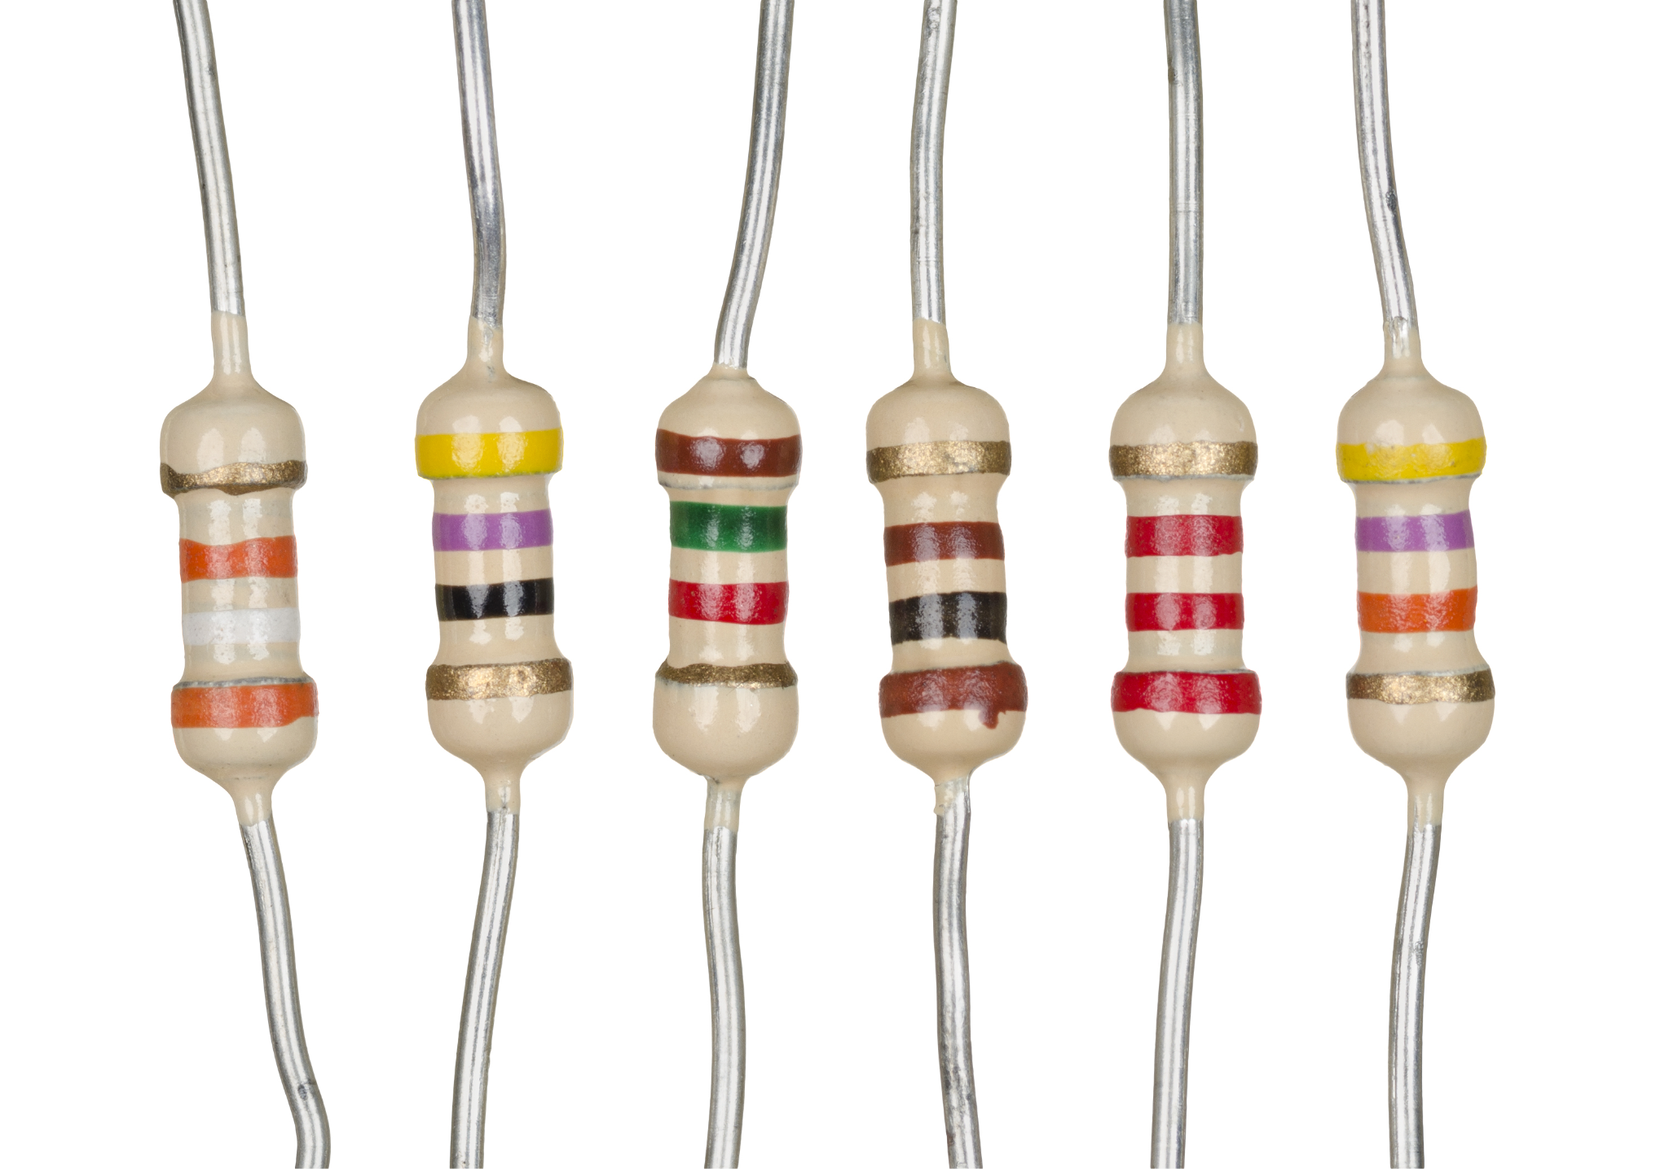
GCSE Electronics
Year 10 2025-26
Top Advice:
Keep your research folder up to date. Nobody else will do it for you!
DO NOT depend upon ‘Google’. You’ll get 2 million irrelevant and useless links.
Use the e-text book. If it’s in there. It might be on the exam
In an exam, NEVER leave a blank response to a question. Every mark counts
Test yourself regularly. There are plenty of self-marking quizzes in the Classroom.
Try and improve your best score
If you don’t understand, then ask me!
Key links:
Bitesize Electronics (Basic circuits)
Bitesize Electronics (Systems)
Technologystudent.com
Eduqas (exam board) website
GCSE Specification
GCSE Electronics e-textbook
D&T online Electronics website
Switches (randomnerd)
555 (randomnerd)
Mr Dunphy’s teaching slides
Subject Leader:
Mr Dunphy - m.dunphy@tgs.starmat.uk
Little and often is the key to success!

Slide 16
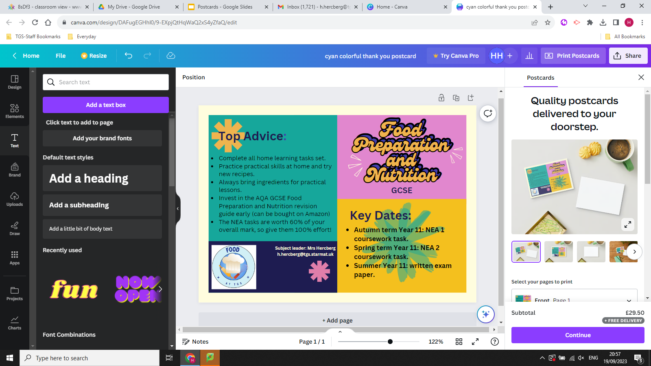

Slide 17
GCSE Graphics
Year 10 2025-26
Top Advice:
Stay on top of deadlines. They are planned out so that you do not become overwhelmed when it comes close to submission dates
Aim to do 1-2 hours extra in your own time every week. This can be at lunch times, after school sessions or at home
Try to do as much practical work in school as possible and screen dump in to slides because you can then do this at home.
If you haven’t got Photoshop or Illustrator at home etc this is the most efficient way to work.
Key Dates:
Non-Exam Assessment
60% Internally set practical projects (two projects will be covered)
Externally assessed Exam
40% Externally set practical project ending in a 10 hour practical exam (one project)..
Project deadlines will be set throughout the year.
Subject Leader:
Mr Andrews - j.andrews@tgs.starmat.uk
Little and often is the key to success!

Slide 18

GCSE Health & Social Care
Year 10 2025-26
Top Advice:
Talk to family members of all ages about their life stages liked to their physical, intellectual, emotional and social development.
Watch TV documentaries about the NHS and child development: some examples include: Ambulance” (BBC One / iPlayer)
GPs: Behind Closed Doors” (Channel 5 / My5)
Old People’s Home for 4 Year Olds” (Channel 4 / All4)
The Secret Life of 4, 5 and 6 Year Olds” (Channel 4 / All4)
Hospital” (BBC Two / iPlayer)
Use : https://quizlet.com → search “BTEC Health and Social Care”
Key Dates for Y10:
Unit 1 - Human Lifespan Development (internally assessed)
In class controlled assignment in Year 10
March - May 2026
Unit 2 - Health and Social Care Services and Values (internally assessed)
In class controlled assignment in Year 11
October - December 2027
Unit 3 - Health and Wellbeing (externally set and assessed exam)
May/June 2027
Subject Leader: Mrs Hercberg h.hercberg@tgs.starmat.uk
Mr Vernon r.vernon@tgs.starmat.uk
Mrs Thornton j.thornton@tgs.starmat.uk
Empathy and kindness is important!

Slide 19
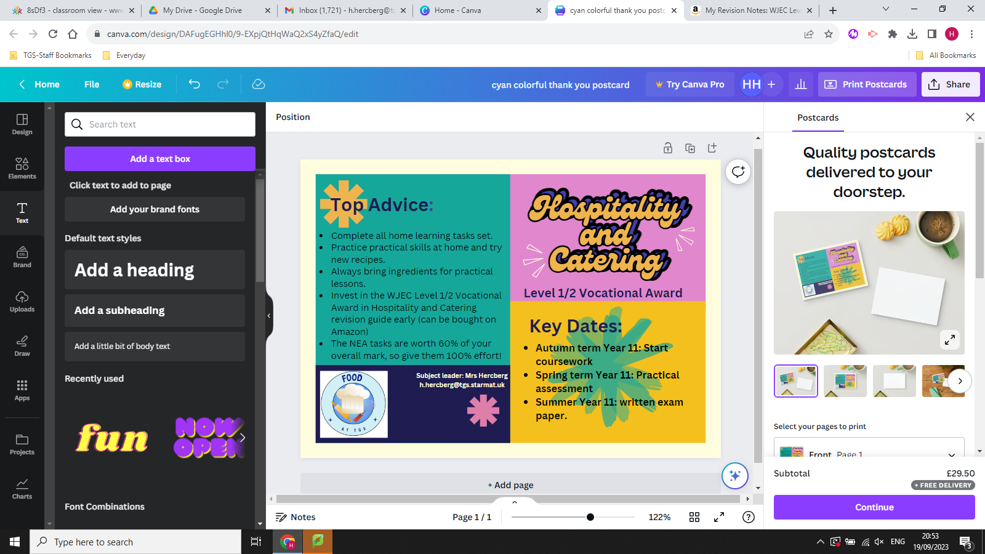

Slide 20

GCSE Music
Year 10 2025-26
Top Advice:
Please make sure you are having instrumental/vocal lessons - we have lessons available at school from the North Yorkshire Music Hub.
You must aim to do performance practice every day for at least 15 minutes.
Make sure you get involved in at least one extra-curricular Music activity each week.
Get the revision guide (link on our classroom) and use it to fill in your keywords booklet as we go through the course.
Key information
Y10 Music is spent building skills to enable students to perform and compose effectively in Y11. Students will also explore the 4 Areas of Study - Musical Forms and Devices, Ensemble, Film and Pop Music.
Performing - 30% Assessed through two performances in Y11 - solo and ensemble.
Composing - 30% Assessed through two compositions in Y11 - free and to a given brief.
Appraising - 40% Assessed through a Y11 exam.
Subject Leader: Mr Rodaway
c.rodaway@tgs.starmat.uk
Practice, practice, practice!

Slide 21
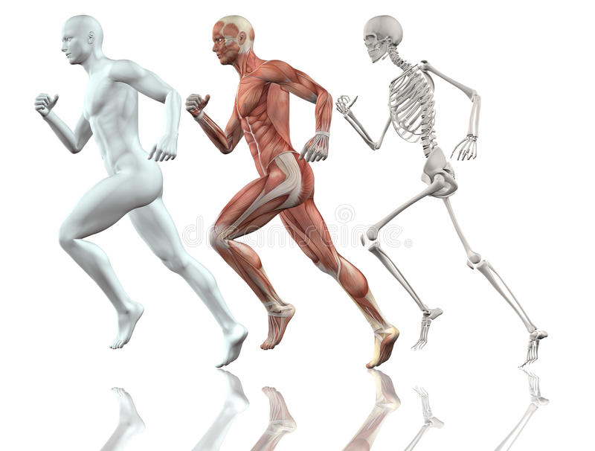
GCSE PE
Year 10 2025-26
Top 7 Tips:
Practice exam style questions.
Learn command words & definitions.
Use the ‘PEECI Blinder’ method when using sporting examples in AO3 responses.
Know ‘components of fitness’, ‘fitness testing’ and ‘methods of training’ inside out.
Use learned planning structure for your six and nine mark answers (AO1/2/3).
Complete as many past papers as possible - learn the markscheme!
Attend as many revision sessions as possible!
Key Dates for Year 10 (and Year 11):
June 2026 - Paper 1 Mock
November 2026 - Paper 1 Mock
February 2027 - Paper 2 Mock
Easter 2027 - Practical Moderation Day
Assessment InformatioN:
2 exams at the end of Year 11:
Paper 1 - 30%: Anatomy and Physiology
1 hour and 15 minutes
Paper 2 - 30%: Socio-cultural Influences
1 hour and 15 minutes
Non-Examination Assessment - 40%
3x practical performance & coursework
Examination PE Leader: Kris Pennock
k.pennock@tgs.starmat.uk
Hard work beats talent!

Slide 22

GCSE RPE
Year 10 2025-26
Top Advice:
Learn your key terms- if you know your key terms you will understand any question and be able to answer everything in some way.
Learn at least 5 quotes per unit- this will enable you to use quotes to gain higher marks- lots of quotes can be used for many areas for example:
‘Do not kill’, Sanctity of life- abortion, death penalty, Euthanasia.
Learn the written structures per question- this will ensure you are not panicked regarding how much to write.
For example: Question 4 6 marks is P (point) E (explain or example) x2 AND make sure you add a quote -DO NOT PLONK IT!.
Key Dates for Y10:
At the end of each unit there will be an end of unit assessment.
Crime and Punishment- Half term 2
Religion and Life- half term 3/4
Islamic Beliefs half term 5
Mock - Families and relationships and Islamic beliefs - half term 6
AQA A Religious Studies
Ben Wardle is an online teacher on YouTube.
AQA A religious studies flashcards are very user friendly.
Subject Leader: Ms T Askew
t.askew@tgs.starmat.uk
Enjoy a good debate!

Slide 23

Sports Studies
Year 10 2025-26
Top 7 Tips:
Practice exam style questions.
Learn command words & definitions.
Make the most of lesson time to complete NEA coursework.
Practice and refine your Sports Leadership coaching session to ensure success and the highest mark possible.
Complete as many past papers as possible - learn the markscheme!
Make sure you are informed and up to date with what is going on in the world of sport!
Use the textbook resource to support your NEA coursework and Exam Unit revision.
Key Dates for Year 10 (and Year 11):
Year 10 (NEA Units)
Unit R187: Outdoor and Adventurous Activities
Unit R185: Performance and Leadership
Year 11 (Exam Unit)
Unit R184: Contemporary Issues in Sport
R184 Mock Exam February 2027
R184 Exam sat at the end of Year 11
Assessment InformatioN:
Unit R184 (Exam Unit): 40% of final grade
Unit R185 (NEA Unit): 40% of final grade
Unit R187 (NEA Unit): 20% of final grade
Examination PE Leader: Kris Pennock
k.pennock@tgs.starmat.uk
Hard work beats talent!

Slide 24
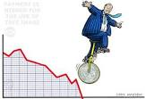
GCSE Business
Year 10 2025-26
Top Advice:
Use your Google Classroom! All the resources are there – past papers, interactive activities, videos and topic notes. Make it your go-to for revision!
Learn the key terms Know words like entrepreneur, revenue, profit, market segmentation. Clear definitions are quick marks.
Use real business examples Connect theory to real companies – like Tesco, Greggs, or GlaxoSmithKline – to show understanding.
Answer the question! Pay attention to command words (describe, explain, analyse, evaluate). Tailor each answer carefully.
Explain cause and effect Show why decisions happen and what impact they have on the business, customers or the market.
Structure your answers Use PEEL: Point → Explain → Example → Link back. It makes your answers clear and easy to mark.
Revise regularly Short, frequent revision beats last-minute cramming. Use quizzes, flashcards and past questions to stay sharp.
Key Dates:
Method of Assessment in Year 10
Summer Exam Paper 1
Written Examination: 1 hour 45 minutes
80 marks - 50% of GCSE
Mini Assessments
Prepare properly for Mini Assessments
Prepare properly for the Y10 exam by completing at least 3 full paper 1s. These are on the Google Classroom with exemplar answers.
Subject Leader: Mr Benoit
c.benoit@tgs.starmat.uk
Business is all about strategic vision!

Slide 25
GCSE Economics
Year 10 2025-26
Top Advice:
Use your Google Classroom! Everything you need is there – past papers, interactive AI activities, Quizlets for each topic, revision videos and topic resources. Make it your first stop for success!
Know your key terms Always define key concepts like demand, opportunity cost and inflation. Clear definitions = easy marks!
Use real examples watch the news Apply ideas to real events – like rising fuel prices, supermarket competition or changes in interest rates.
Explain cause and effect Don’t just state facts – explain why something happens and how it affects consumers, firms or the economy.
Structure your answers Use PECAN: Point → Explain → Contextual Analysis → Link back to the question. It keeps your writing clear and focused.
Revise smart Little and often beats last-minute cramming. Use flashcards - these are on the classroom, quizzes and short practice questions to keep knowledge fresh. All past paper and answers are on the classroom
Key Dates:
Method of Assessment in Year 10
Summer Exam Paper 1
Written Examination: 1 hour 45 minutes
80 marks - 50% of GCSE
Mini Assessments
Prepare properly for Mini Assessments - use the Quizlets on the classroom to revise topic areas
Prepare properly for the Y10 exam by completing at least 4 full papers
Subject Leader: Mr Benoit
c.benoit@tgs.starmat.uk
Economics is in every choice you make

Slide 26
BTEC Enterprise
Year 10 2025-26
Top Advice:
Component 1
Use your Google Classroom – Assignment Briefs, research material, Active learn and assignment guidance is all in there
Understand different enterprises – Know the types, purposes, and examples of real businesses.
Focus on entrepreneur skills – Show how qualities like creativity and resilience are important.
Research your market – Find out about customers, competitors, and trends. Evidence is key!
Plan your work – Break tasks into steps and stick to deadlines.
Keep everything documented – Record ideas, decisions, and research clearly.
Review and improve – Check your drafts, fix mistakes, and show you’ve refined your work.
Key Dates:
Timeline & Key Tasks (Sept → May)
September (Start) — Introduction; students choose their enterprise & entrepreneur and begin background reading.
By end Oct — Collect secondary research (company reports, news) and plan primary research (simple survey or short interview).
November — Complete Task 1 prep (notes on enterprise activities, entrepreneur skills & how aims are met). Prepare up to six sides of A4 permitted notes
Dec–Jan — Carry out market research (Task 2): run survey/questionnaire, gather competitor info, start analysing results.
Feb — Finalise Task 2 write-up and recommendations (what to improve/how to reach customers).
Mar — Research external factors for PEST and internal/competitive issues for SWOT (Task 3).
Early April — Prepare concise bullet notes for supervised sessions (remember notes must not contain pre-written analyses or full paragraphs)
April (supervised assessments) — Students complete the formal supervised tasks (total approx 5 hours supervised; monitored prep c.6 hours in advance).
May (Deadline) — Final checked submission ready for external moderation.
Subject Leader: Mrs Douglas
a.douglas@tgs.starmat.uk
Business is all about strategic vision!

