Slide 1


Key Stage 4 Choices 2026 - 2028
Mr Dunphy
Assistant Headteacher
Miss Hall
Associate Assistant Headteacher/ Year 9 Year leader

Slide 2
Aims of this Presentation
To give you information about:
The Statutory Courses that ALL students will follow next year
The Optional Courses which are available for you to make your four choices
The Types of qualifications available
The support and guidance which has been, and will be provided during this process

Slide 3
Planning for YOUR Future
Over the coming weeks, you should be actively doing the following:
READ the options booklet you have been given
Discuss your choices with your form tutor
Seek out Careers advice, and go to meetings when invited
Look at the website information about each course
Pay attention to guidance in Personal Development lessons
Listen to your teachers in each subject as they provide information in lessons
Decision time – by FRIDAY 6th FEBRUARY

Slide 4
Statutory Courses ALL students will study:
English Language and English Literature
(2 GCSEs)
Mathematics (1 GCSE)
Science (up to 3 GCSEs)
Personal Development
Physical Education (can also be an option)
Notes:
‹#›
Year 9 Assembly Presentation

Slide 5
4 options?
Now it is time to choose your other 4 subjects

Slide 6
Decisions, Decisions…
You need to think carefully about:
new challenges and opportunities
previous success in each subject area
types of assessment in each course (read the booklet!)
your future career options (but not too much!)
what you enjoy most!

Slide 7
Decisions, Decisions…….
Do NOT consider:
what your friends are planning to do.
They may well NOT be in the same class as you, even if you choose the same subjects. You might even have a new friendship group when you start Year 10.
which teachers you like this year
You are unlikely to get the same teacher as in Year 9. circumstances can change. Your favourite teacher may even get a new job somewhere else!

Slide 8
What are the types of course on offer?
Most courses here at TGS are GCSEs which are graded 1 - 9.
(9 is the top grade)

Slide 9
…but there are other equally useful qualifications too….
Cambridge Nationals
Technical Awards
NCFE Certificates
BTEC qualifications

Slide 10
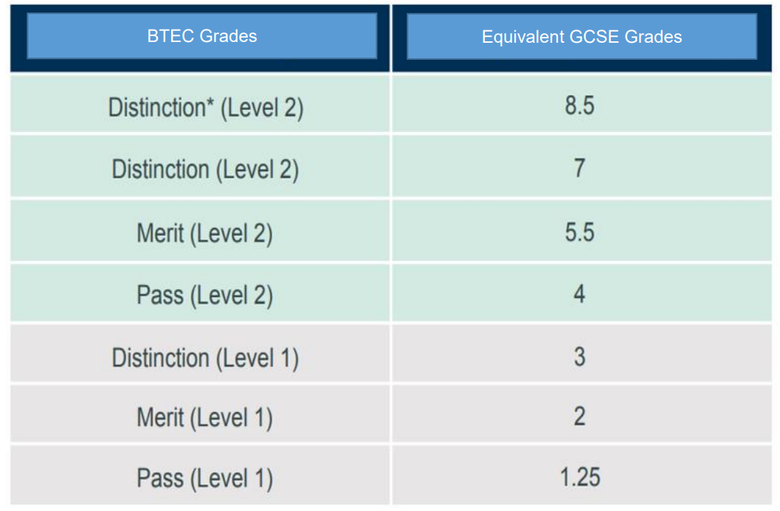
It is just a different journey…
BTEC Grades
GCSE equivalent
is equivalent to a GCSE grade
is equivalent to a GCSE grade
is equivalent to a GCSE grade
is equivalent to a GCSE grade
is equivalent to a GCSE grade
is equivalent to a GCSE grade
is equivalent to a GCSE grade

Slide 11
Most GCSEs have exams at the end of Year 11.
Many of the other courses have ‘modules’ or ‘units’ which add up to a final grade. Some of these will be taken in Year 10. They all add up to the same thing.

Slide 12
GCSEs
BTEC / Vocational
Year 10 Year 11

Slide 13
Ask yourself….
How does it suit how you like to learn?
exam-based, practical, coursework?
Consider your preferred mode of study and assessment

Slide 14
In some subject areas there is a choice between GCSE and other types of qualification:

Slide 15
For example, you might choose to study
Business Studies GCSE or Business (Enterprise) BTEC
PE GCSE or Sport Studies Cambridge National
Food Preparation or Hospitality & Catering Level 2
staff within each subject area will guide you

Slide 16
What was the EBacc?
The EBacc or ‘English Baccalaureate’ is no longer a measure used by the Department for Education. It was not a qualification in itself, but represented the recognition of a ‘pass’ in:
English Language & Literature
Maths
Science (Physics, Biology, Chemistry and Computing)
A Modern Foreign Language
Geography or History
We have never made EBacc combination of options mandatory, so we do not envisage significant changes to our current curriculum.

Slide 17
What are the subjects I can choose?

Slide 18
Option 1
Computer Science
French
German
Geography
History
You MUST choose at least ONE of these subjects

Slide 19
Other option choices
Art & Design : Art, Craft & Design
Art & Design : Photography
Business GCSE or Enterprise BTEC
Computer Science
Creative Media Production
Design & Technology : 3D Product Design
Design & Technology : Graphics
Drama
Economics
Electronics
Food Preparation & Nutrition or Hospitality & Catering
French
Geography
German
Health & Social Care
History
Music
Physical Education or Sport Studies
Religion, Philosophy & Ethics

Slide 20
Will I definitely be able to study all of my choices?

Slide 21
We will do our very best to offer every student the courses they select, but….
Some combinations of subjects might not fit into the timetable. If there is a ‘clash’, you will need to select a different course.
No…

Slide 22
If TOO FEW students opt for a subject, we will not be able to offer this course.
This is why we ask you for a ‘reserve’ choice on the options form
or….

Slide 23
Remember…
These subject choices do not shape the rest of your life.
Don’t put pressure on yourself.
Pick ones that you will enjoy.

Slide 24

Careers Guidance Tips to help with subject choice

Slide 25
Research course content- make sure that you will enjoy what you will be studying. Subjects will be more focussed and in depth than your current study of them.
Research and ask teachers about their subject and read up about the course. Is it a mandatory subject needed to study Post 16 options? If you are considering studying A-levels in the future then certain subjects may require you to have previously studied the subject at GCSE. If this is the case it would be advised to look at the sixth form prospectus and check out specific GCSE entry requirements for subjects of interest.

Slide 26
How do I make my choices?

Slide 27


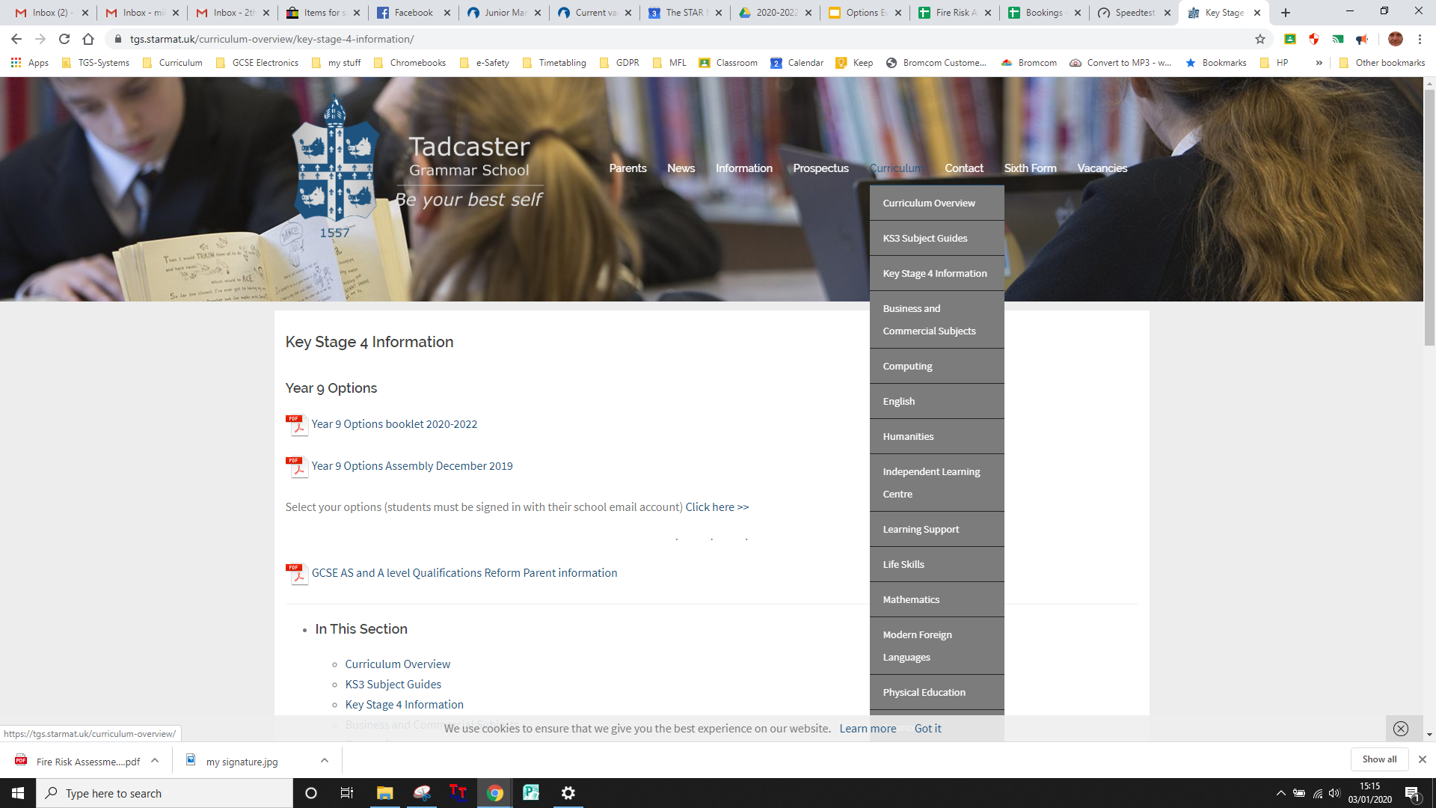


Curriculum
Key Stage 4 options
booklet link
Options form link
School website

Slide 28
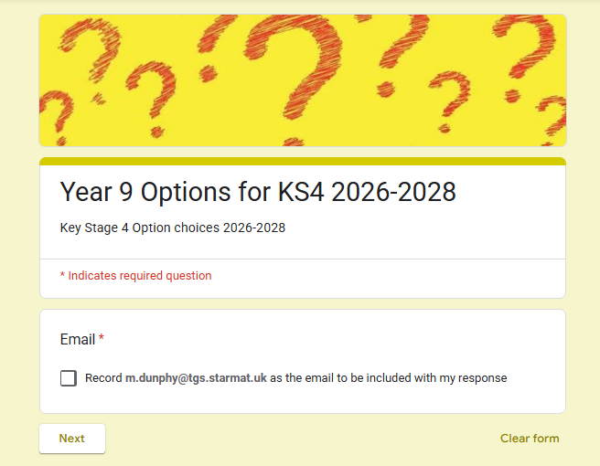
Your email

Slide 29
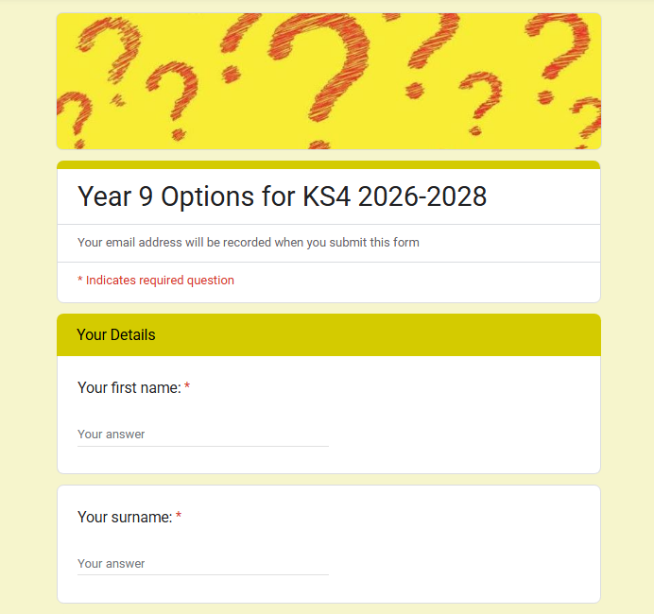
Your FULL name

Slide 30
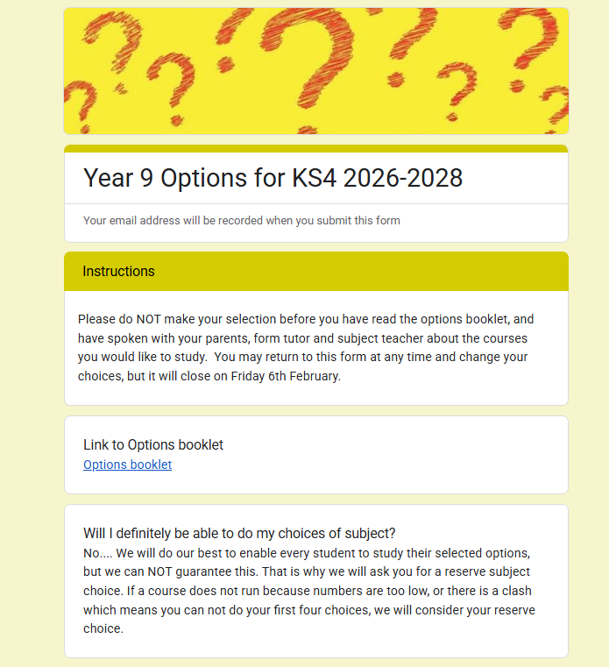
Read the instructions

Slide 31
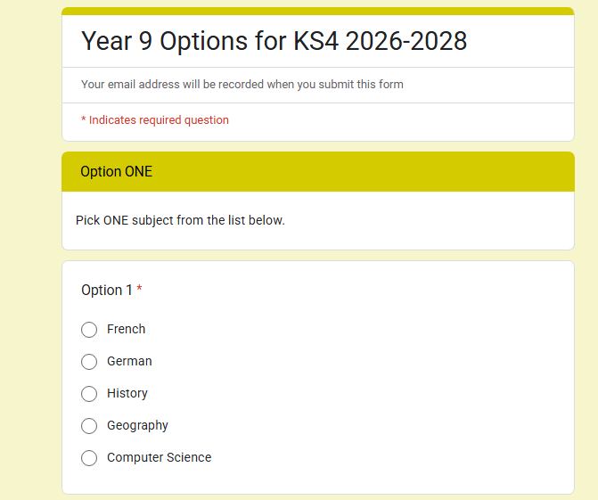
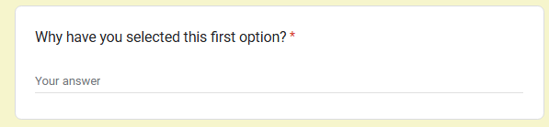
make your choices
Say WHY for each

Slide 32
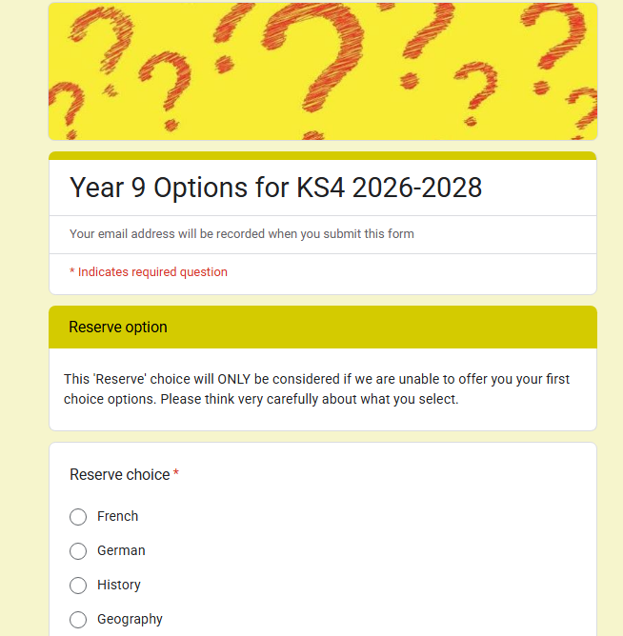
Choose a ‘reserve’ subject

Slide 33
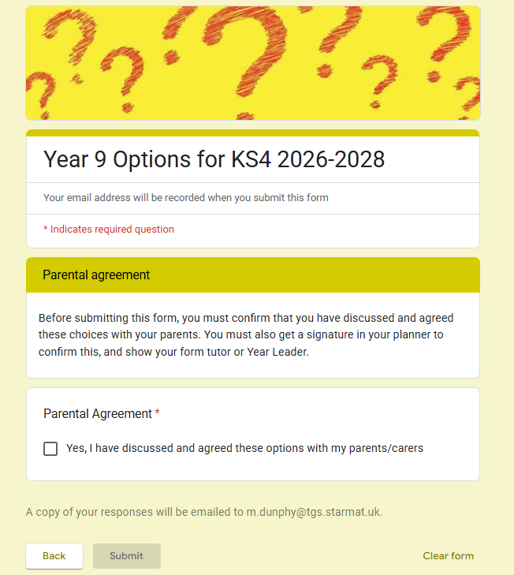
Discuss with your parents
click ‘Submit’

Slide 34
Key Dates:
Wed 28th / Thu 29th January
Parents’ Evening (subjects)
Friday 6th February
options form closes
Notes:
‹#›
Year 9 Assembly Presentation

Slide 35
Remember to…..
Ask questions, talk to your parents and teachers, discuss with your form tutor
Complete your Options Form by 6th February at the latest!
It is NOT ‘first come, first served’, but if your form is LATE you may not get all of your choices!

Slide 36

Class of 2028
August 2028 Results day
February/March 2028 Mocks (tbc)
November 2027 Applications open for Post 16 and Mocks (tbc)
July 2028
Prom!
September 2027 Start of Year 11
POST 16 DESTINATIONS
GCSE 2028 Exam Series May- June 2028
Summer Term 2027 - Mock Exams
September 2026 Start of Year 10
July 2025
Water Sports Trip
September 2025 Start of Year 9
January 2026 GCSE Option Evening
February 2026 Year 9 Reports 1 and Deadline for GCSE Option Choices
July 2025
Year 8 Enrichment Week
Year 8 Information Evening
Economic Change
Easter 2026 - Year 9 Ski Trip
September 2024 - Start of Year 8
June 2024 Year 7 Reports 2
Easter 2024 Silent Disco
September 2023
Year 7 Induction Day
February/March 2025 Year 8 Reports 1
February 2025 Legally Blonde Junior
Enrichment Week 2024 - Year 7 Residential - Bushcraft
February 2024
High School Musical Junior
Year 7 Reports 1
Notes:
MHA

Slide 37

Home Learning
Attendance Matters
Equipment and Uniform
Punctuality to lessons
There are 350 Teaching days in Year 10 and 11 Combined

Slide 38
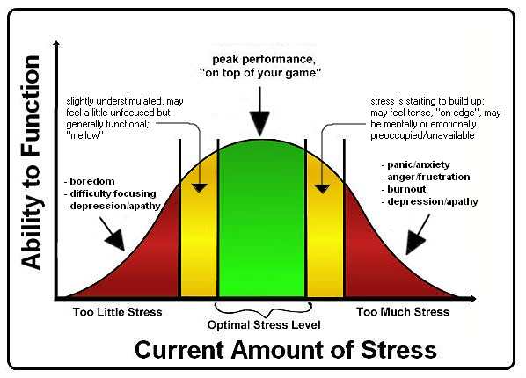
Stress Continuum

Slide 39







School links
Year team
and whole
school
staff support

Slide 40
Key Stage 4 Choices 2026 - 2028
Mr Dunphy
Assistant Headteacher

